Slide 1

Cone crusher KM 65 & KM 65 with divider
Notes:
when cubic particles need to be produced, or for crushing thermally sensitive products or very hard materials
Comminution is achieved by a shear stress between the slowly rotating crushing cone and the stationary outer grinding ring. In order to adjust the fineness of grind, the crushing gap between the crushing tools can be infinitely varied by rotating the feed hopper. Due to the toothing on the fine cone, final finenesses of max.
The KM 65 cone crusher can optionally be equipped with a dividing device

Slide 2
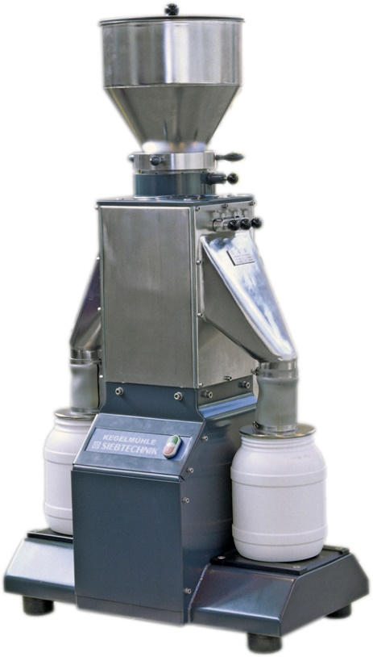
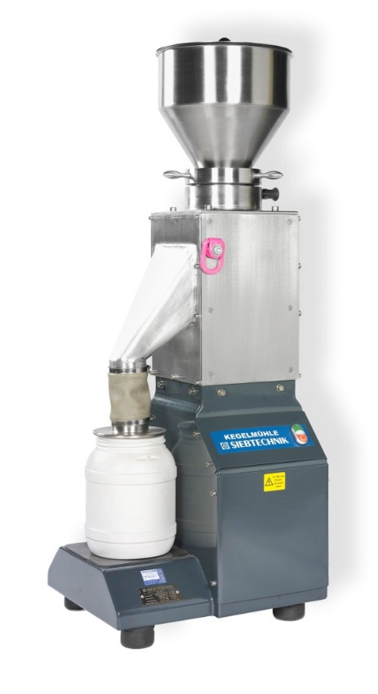
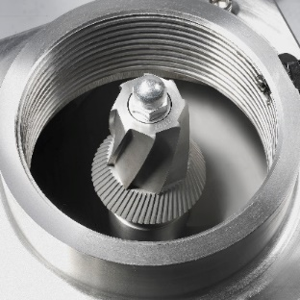
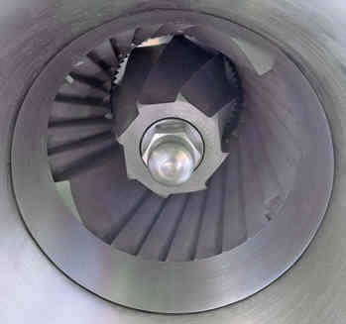
Cone crusher KM 65 & KM 65 with divider

Slide 3
General information
Different sizes:
KM 65 (inner cone diameter: 65 mm)
KM 170
Advantages:
Checking and cleaning is very easy
Integrated dividing ratio 1:2, 1:4 and 1:8.
The grinding cone is made of tungsten carbide
The cubic shape of the particles to be milled is essential for moisture milling

